Slide 1
INTERNAL ONLY
Why are we changing the slides?
Be more consultative
Make the kick off more collaborative
KYC & verify we align on customer KPIs
Q2R
Align on the role of the admin
Prep for analysis/discovery
Define next steps
Notes:
Show confidence, friendliness, professionalism. Leverage every minute, even casual, to build relationships
Remember that they are people, get to know them

Slide 2
Client name &
DealHub
Project Kick Off
<Presenter Full Name>
<Title>
<Date>

Slide 3
Agenda
01
02
03
Welcome to DealHub
Getting to know you
Project timeline
04
05
Team & responsibilities
Next steps

Slide 4
Welcome to DealHub
01

Slide 5






DealHub Reach
Global Enterprise Experience
Founded 2014
250 Employees
12 Locations
>800 Customers
30 Countries

Slide 6































































Trusted by the most respected brands

Slide 7







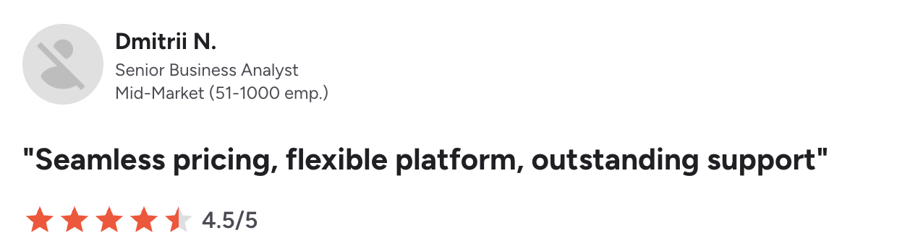
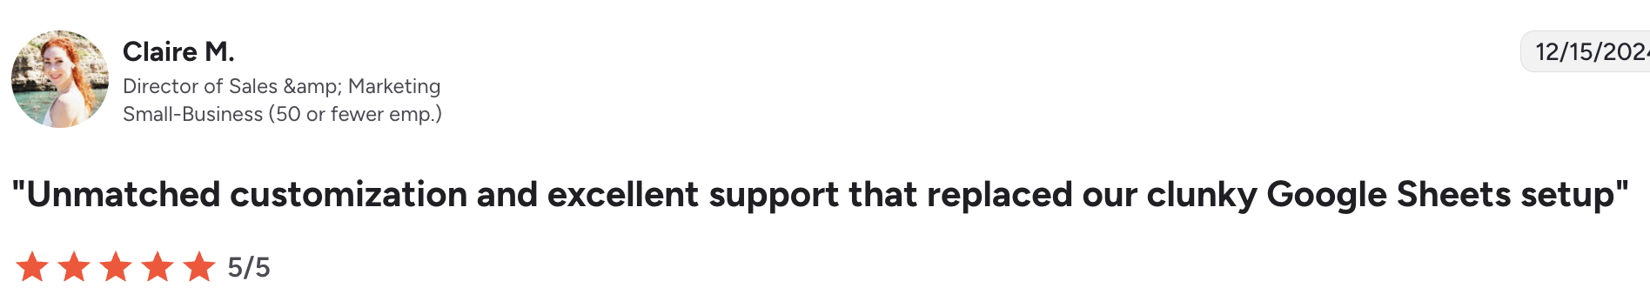
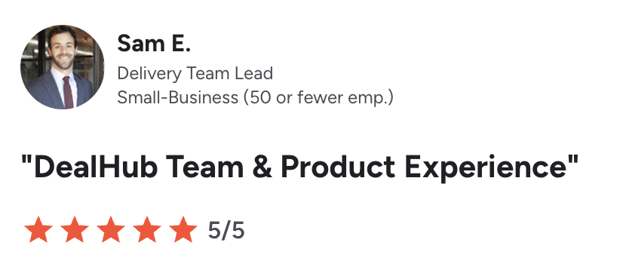
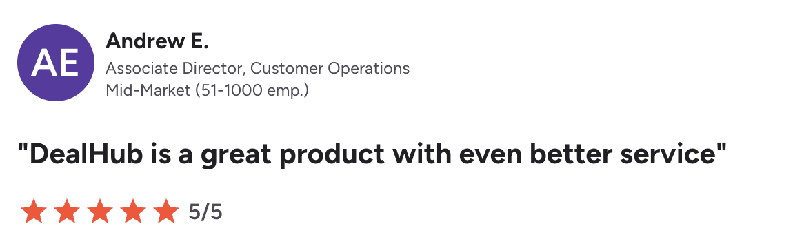
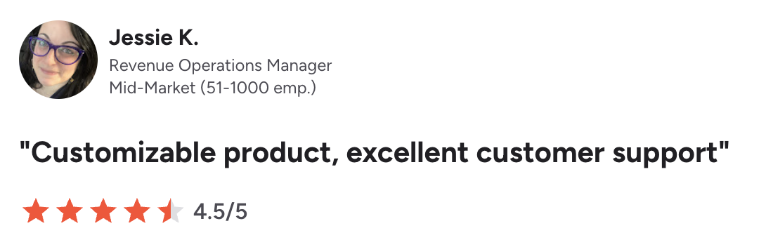
Award-Winning CPQ Platform

Slide 8

Your DealHub Team
 | <Name> Customer Success Manager | Your trusted advisor throughout your journey at DealHub. Deliver on time, on budget and on quality implementation
 | <Name> Solution Architect | Translate your business requirements into a working solution. Technical authority, de-risking complexity, ensure efficient & scalable design.
 | <Name> Solution Expert | Functional and product expert. Ensuring optimal use of system capabilities. Approver to the specific configuration before UAT and Go Live
 | <Name> VP of Customer Success | Your executive-level contact at Dealhub to discuss strategic issues and ensure your satisfaction

Slide 9
Your DealHub Team
 | <Name> Customer Success Manager | Your trusted advisor throughout your journey at DealHub. Deliver on time, on budget and on quality implementation
 | <Name> Solution Architect | Translate your business requirements into a working solution. Technical authority,, de-risking complexity, ensure efficient & scalable design.
 | <Name> Solution Expert | Functional and product expert. Ensuring optimal use of system capabilities. Approver to the specific configuration before UAT and Go Live
 | <Name> VP of Customer Success | Your executive-level contact at Dealhub to discuss strategic issues and ensure your satisfaction
 | <Name> SVP of Account Management | Aligns customer investments to business goals and vision Helps identify and unlock additional value to maximizes impact from the platform
Use with AM in Kick off

Slide 10




Our Philosophy
We are in it together!
Hand in hand til you take control of your system
Working with Ops and the end users to achieve results
Partnership
Drive for results, fast!
Define MVP, phases and rollout strategy
Follow Best Practices
Rapid time to value
Adapt, Improve, Simplify!
Leverage the implementation to simplify processes and align with best practices

Slide 11
Getting to know you
02

Slide 12






Your High Level Solution
CRM
Portal
PLG
Consumption
ERP
SLG
Billing & Revenue
Quote
Subscriptions
Unified Product Catalog & Pricing Engine
Quote-to-Revenue
Use this layout for Q2R projects

Slide 13

Your High Level Solution
CRM
ERP
Portal
PLG
Consumption
SLG
Quote
Subscriptions
Billing & Revenue
Use this layout for CPQ only projects

Slide 14
Getting to Know You
Why now?
Business & offering
Drivers, urgency, goals, current pain points / gaps / friction
Your customers (type, number), your products, packaging, pricing mode, currencies, entities
Selling motion & stakeholders
Billing motion
GTM, Renewals, Billing - roles, decision makers
Payment providers, Tax mechanism and Vendor, In which currencies are you selling, invoices languages
PLEASE UPDATE FOR YOUR CUSTOMER - REMOVE BILLING IF NOT REQUIRED

Slide 15
How Do We Measure Success?
Goal | Why? | How to measure it?
Improve buyer experience | Increase close rates and sales velocity | Proposal generation time Time from quote sent to signature Close rate (proposal → order)
Improve margin visibility and control | Enable profit-aware quoting | Margin visibility within quotes Reduction in pricing / margin errors
Automate renewals & amendments | Scale renewals and reduce manual errors | % of automatic renewals Time to produce a renewal quote
Streamline quoting | Reduce friction and quote cycle time | Time to generate a quote Time to approve a quote
Establish a single source of truth | Data integrity and accurate r | Reduction in manual data corrections
PLEASE UPDATE FOR YOUR CUSTOMER - Use insights from the sale cycle to pre-populate or review in a pre-kick off with the customer

Slide 16
How Do We Measure Success?
Goal | Why? | How to measure it?
Process Automation | Reduce manual work | X% of the manual invoice generation was moved to the billing automation Invoice generation time was reedus from X to Y
Accurate Billing | Prevent revenue leakage and maintain customer trust | #/% of manual billing interventions number of billing corrections or disputes
Improving time to collect | Incorrect/missing payment method info Challenging process for overdue Invoices | Reducing collection errors + Dunning process for overdue Invoices (automation)
Improve Customer Information - Data collection | Lacking critical Info for customer Invoicing, causing back and forth with GTM team to complete missing data | Collecting all relevant data for accurate invoice calculations Reduce/Eliminate GTM teams dependency Unified structured process for data collection
PLEASE UPDATE FOR YOUR CUSTOMER - REMOVE BILLING IF NOT REQUIRED

Slide 17
Project timeline
03

Slide 18
Main Milestones: DealHub Implementation
1
Initiation
3
System Set Up
5
Go-live
Kickoff Meeting
KPI and R&R Alignment
Solution Overview
Baseline Project Plan
Start the Admin Training
Joint Configuration sessions
Offline Configuration
System Integration
Solution Review & demo
Tests & Updates
Data Migration
Production Set Up
Production Data Migration
Hypercare
Verify Adoption (Round tables)
2
Analysis & Design
4
UAT & Enablement
Review current state and define future use cases
Data Migration Preparation
Solution Design
Integration Design
End User UAT
UAT fixes & Sign off
Enablement & Change Management - Sales, Renewals, Finance, Legal

Slide 19

Typical Implementation Timeline
Early Phase
Core Implementation
Launch
Week
1
2
3
4
5
6
7
8
9
10
11
12
13
14
15
16
Initiation & Preparation
Sprint Review
Sprint Review
Sprint Review
Analysis & Design
System Set Up
Data Migration
UAT & Enablement
Steering Committee
Steering Committee
Go-Live & hypercare
Project Management
Customer
Let’s align: Any completing events?
Strategy changes\availability constraint that may impact the timelines?
KickOff
Go Live
Joint
* Timeline are indicative and depend on final scope, timely customer inputs & decisions. The actual project plan will be agreed after the Analysis & Design phase.
.
Notes:
During the system set up, we will work hand in hand with your system administrator to set up the system
We will work a predefined sprint cadence, and will schedule sprint review where we will share the latest and greatest with the wider team to validate the approach, get early feedback and adjust where needed
Steering committee

Slide 20
Team & responsibilities
04

Slide 21
Your Team - Who, When, What...
Role | Initiation | Solution Design | Build | UAT & Enablement | Go-Live
DealHub Admin | Complete admin training & certification | Participate in design sessions and help drive decisions | Configure with DealHub and independently | Triage and fix issues, Sales Training | Own post go-live administration
Sales Business Owner | Walk through current sales process | CPQ design approval & sign-off | Help build internal enablement & change management plan; Sprint review | Test, validate, sign-off | Act as a champion and help drive adoption
Sales Rep |  |  | Sprint review | Test & validate | Provide feedback
Legal |  | Provide templates & T&Cs (MSA, NDA, etc.) |  | Test & validate

Slide 22
Your Team - Who, When, What...
Role | Initiation | Solution Design | Build | UAT & Enablement | Go-Live
Marketing | Provide brand guidelines | DealRoom / proposal design and content |  | Approve design
Billing Business Owner | Walk through current billing process | Billing design approval and sign-off | Build internal enablement & change management plan, Sprint review | Test, validate, sign-off
Billing Rep |  |  |  | Test & validate | Provide feedback
Project Manager | Owns project planning and cadence, keeps deliverables on track, and ensures stakeholder alignment.
Leadership | Provides executive oversight, escalation, and steering decisions.
Remove Billing if not required

Slide 23
Housekeeping
Tracking progress
Collaboration Tools
Project Plan will be created and maintained in: Monday.com
Weekly Status Reports
Weekly project status sessions (core team). 1 hour meeting to review of project schedule, key issues and risks
Sprint Review Sessions
Steering Committees
Slack\Teams
Zoom\Google Meet\Teams
Google Drive

Slide 24
What’s Next?
05

Slide 25
What’s Next?
 | Item | Description | Audience
1 | Learn about the solution | Administrator - Sign up and start the Admin Certification Course Core Project team - Sign up and complete the Overview | Core project team, DH Administrator.
2 | Overview | High level overview of the user experience and and a glance at the Administration and configuration | Core project team, Administrator.
3 | Workshop Prerequisites | Complete the billing questionnaire and review the preparation document | Relevant SME
For CPQ + Billing project

Slide 26
What’s Next?
 | Item | Description | Audience
1 | Learn about the solution | Administrator - Sign up and start the Admin Certification Course Core Project team - Sign up and complete the Overview | Core project team, DH Administrator.
2 | Overview | High level overview of the user experience and and a glance at the Administration and configuration | Core project team, Administrator.
3 | Workshop Prerequisites | Review the preparation document | Relevant SME
For CPQ ONLY project

Slide 27
What’s Next?
 | Item | Description | Audience
4 | GTM Business Process Discovery | Helps a business map out their entire quote-to-revenue process, from how they sell and price to how deals are structured and approved. | RevOps team, Sales Business owner, DH Administrator, Finance Rep
5 | Billing Workshop | Covers how a business handles billing operations, from invoice generation and payment collection to ERP integration and revenue recognition. | Billing team, DH Administrator
6 | Technical & Systems Discovery | Maps the business/billing processes to the actual technical systems — CRM objects, integration architecture, pricing logic, and data migration requirements. | RevOps team, Sales Business owner, Systems/CRM Administrator
7 | Data Migration Kick Off | Review the Subscription Data Migration options & the process | Billing team, RevOps team, DH Administrator

Slide 28






Get Ready - Required Documents
Please provide the following information prior to the workshop:
Product Portfolio
Offering Structure
Pricing Books
Complete catalog structure including product families, add-ons, services and bundles
Portfolio rules, guardrails, constraints, dependencies, and logic definitions.
Standard price lists, currency conversions, discounts costs, and margin calculations.
Approval Matrix
Brand Book
Sample Contracts
Defined workflows for quote approvals based on commercial thresholds or terms and conditions.
Logos, color codes (HEX/RGB), fonts, and styling guidelines for generated quote documents.
PDF or Word templates of current quotes and contracts to generate via dealhub
Use this layout for CPQ projects

Slide 29
Get Ready - Required Documents
Please provide the following information prior to the workshop:
Product Portfolio
Offering Structure
Pricing Books
Invoice
Complete catalog structure including product families, add-ons, services and bundles
Portfolio rules, guardrails, constraints, dependencies, and logic definitions.
Standard price lists, currency conversions, discounts costs, and margin calculations.
Invoice PDF for all billing scenarios
invoice email template (if invoicing is from DealHub)
Dunning email template
Credit memo PDF
Approval Matrix
Brand Book
Sample Contracts
Defined workflows for quote approvals based on commercial thresholds or terms and conditions.
Logos, color codes (HEX/RGB), fonts, and styling guidelines for generated quote documents.
PDF or Word templates of current quotes and contracts to generate via dealhub
Use this layout for Q2R projects

Slide 30
Recipe for Success
Align clearly on roles & responsibilities.
Who leads the project, who’s on the core team, and who administers the system?
Build better, not the same. Improve your process, don’t replicate.
Design for seller/customer journey. Their journey drives UX, adoption, and value.
Work with the business. Drive the design, validate the solution.
Build for maintainability. Easy to manage, adapt, and scale over time
Work in an agile, iterative way. Deliver value early, learn fast, and adjust as we go
Keep it simple (KISS). Simplicity accelerates adoption and long-term success

Slide 31
Welcome on board .

